Slide 2
What’s new in ASP.NET Core and Entity Framework 2.2 (Preview 3)
Suthep Sangvirotjanaphat
GreatFriends.Biz and .NET Framework Source Code Study Group FB Groups

Slide 3
ASP.NET Core 2.2
Preview 3

Slide 4
Get started with ASP.NET Core 2.2 Preview 3
Install the .NET Core 2.2 Preview 3 SDK
https://www.microsoft.com/net/download/dotnet-core/2.2
Install Visual Studio 2017 15.9 Preview 3
https://visualstudio.com/preview/

Slide 5
ASP.NET Core 2.2 features
Template updates: Bootstrap 4, Angular 6
Web API improvements
HTTP/2
IIS in-process hosting
Health checks
Endpoint routing
SignalR Java client
Parameter Transformation in Routing

Slide 6
Web API improvements in ASP.NET Core 2.2
Easier to create
Easier to test & debug
Easier to document
Easier to consume
Easier to secure
Easier to monitor
Improved performance

Slide 7
Web API improvements in ASP.NET Core 2.2
Easier to create
Easier to test & debug
Easier to document
Easier to consume
Easier to secure
Easier to monitor
Improved performance
→ API Scaffolding
→ HTTP REPL, Problem Details
→ API conventions & analyzer
→ Code generation (Preview 3)
→ Web API security (Preview 3)
→ Health checks integration
→ HTTP/2, endpoint routing, IIS in-proc hosting

Slide 8
HTTP/2
Now available cross-platform in Kestrel
Application-Layer Protocol Negotiation (ALPN)
Header compression
Multiplexed streams over same connection
Some limitations
Server push, stream prioritization not currently supported
Not supported for edge use at this time

Slide 9
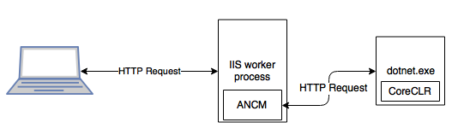
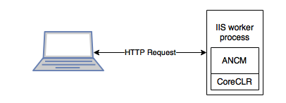
IIS in-process hosting
Out of process (current)
In process (NEW!)

Slide 10
IIS in-process hosting
Improved performance, reliability, and diagnostics

Slide 11
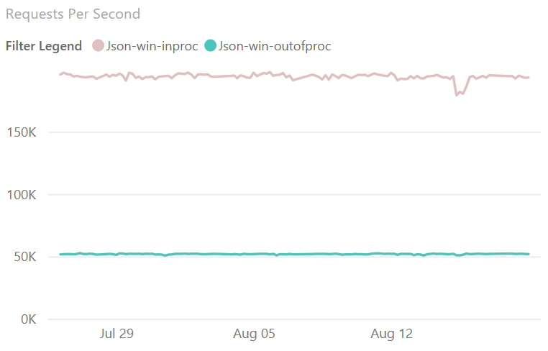
IIS in-process hosting – Performance!
4x
faster!

Slide 12
Endpoint routing
New routing implementation
On by default for 2.2 with compatibility switches
Better throughput (~10%) and scalability
Link to endpoints from outside of MVC
Various minor improvements
Parameter transformers, new catch all syntax {**path}

Slide 13
SignalR Java client
Connect to ASP.NET Core SignalR hubs in Java
Available via Gradle and Maven
Now supports Azure SignalR Service
Complete Android sample
https://github.com/aspnet/SignalR-samples/tree/master/AndroidJavaClient

Slide 14
ASP.NET Core 2.2 schedule
Preview 2 - Sept
Preview 3 – Oct
RTW – Year-end 2018

Slide 15
What’s new in EF Core 2.2 (Preview 3)
Collections of owned entities
Spatial extensions
Query tags
Cosmos DB

Slide 16
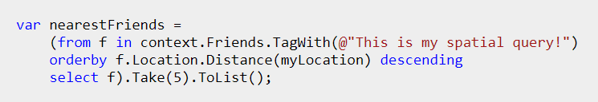
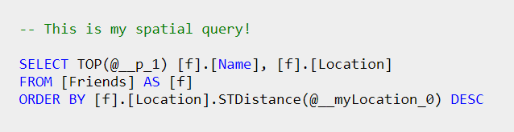
Query Tags

Slide 17
EF Core roadmap
2019
Cosmos DB provider
2018
Query tags
C# 8 support:
Nullable reference types
Standard IAsyncEnumerable<T> interface
Improved LINQ implementation
EF Core 2.2
Aggregate behaviors
Public code first conventions
Ignore parts of the model for Migrations
EF 6.3 running on .NET Core 3.0
EF Core 3.0
Spatial extensions for SQL Server and SQLite
Reverse engineering of database views
Collection of owned entities
Property bag entities

Slide 18
Only in EF6
Only in EF Core
Entity splitting
Batching of statements
Mixed query evaluation
Shadow properties
More readable SQL
Client key generation
Field mapping
Rich value conversions
DbContext pooling
Simple function mapping
Alternate keys
Disconnected graph API
Query types (no keys)
Change tracking proxies
Stored procedure mapping for CUD
Visual designer
TPT, TPC inheritance
Simple logging API
Database-agnostic SQL dialect
Interception extensibility
DI and service replacement
LINQ composition over raw SQL
Non-default constructors
In-memory provider (for testing)
Global query filters
Common features
Seed data
Lazy loading
Connection resiliency
TPH inheritance
Compiled queries
GroupBy translation
Any type from raw SQL
Eager loading for derived types
Cross-platform & .NET Standard
System.Transactions
Change tracking events
Complex/owned types
Table splitting
Eager loading
Rich diagnostics and logging
Many-to-many
Spatial data*
Cosmos DB provider*
Collections of owned entities*
Query tags*
Reverse engineering of database views*
* New in EF Core 2.2

Slide 19
Entity Framework 6.3 on .NET Core 3.0
Cheapest way to move existing app to .NET Core
EF Core 3.0 will still be recommended
No new features in EF6 (but we’ll consider PRs)
Cross-platform (Windows, Linux, Mac)
No spatial support for SQL Server
Providers will need to port too
EF Designer may require workarounds

Slide 20
EF Core 2.2 – Final message
Demos available at https://aka.ms/efcoredemos
WE REALLY NEED YOUR FEEDBACK! Please try:
Microsoft.EntityFrameworkCore.SqlServer
Microsoft.EntityFrameworkCore.Cosmos.Sql
Microsoft.EntityFrameworkCore.SqlServer.NetTopologySuite
A big thank you from the EF team!

Slide 21
Thanks Follow me at GreatFriends.Biz https://fb.com/groups/greatfriends.biz

